Slide 1
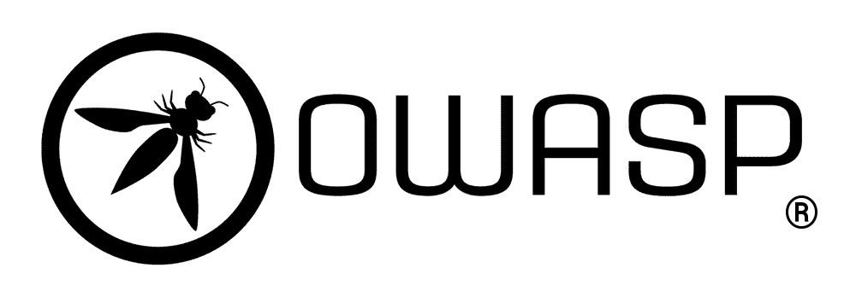
OWASP Top Ten 2022
Anish Bhattarai

Slide 2
What is it about?
The Open Web Application Security Project (OWASP) is a nonprofit foundation that aims to improve software security by publishing industry standards, articles, tools, and documents. An example of the kind of tools it provides is the OWASP Risk Assessment Framework, which combines static application security testing and risk assessment tools.

Slide 3
The most recent OWASP Top 10 update from 2021 carries over to 2022. The 2021 update adds three new categories of risk to the previous update in 2017, along with some consolidation and re-naming.

Slide 4
1. Broken Access Control
Broken access control vulnerability is a type of security flaw that allows an unauthorized user access to restricted resources.
Annual revenue growth

Slide 5
2. Cryptographic Failures
Cryptographic failures refer to either a bad implementation of encryption or a complete lack of encryption.
Annual revenue growth

Slide 6

3. Injection
Injection is a risk category that refers to the ability of threat actors to provide malicious input to web applications that result in the app executing unexpected and unwanted commands.

Slide 7
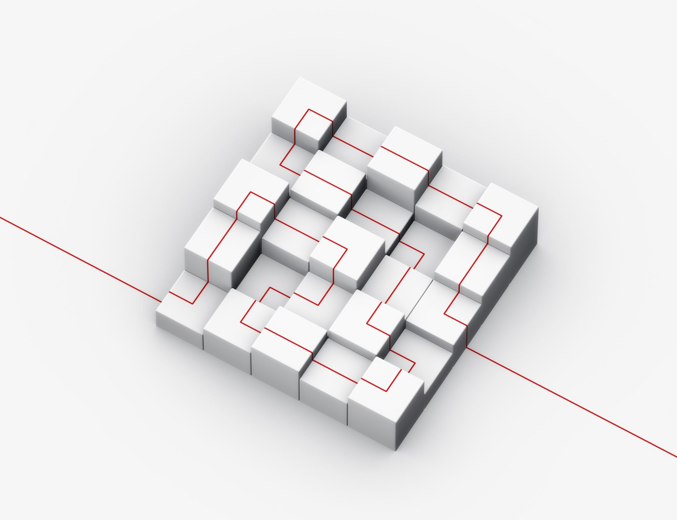
4. Insecure Design
This is an entirely new category for the OWASP Top Ten, focusing broadly on application design and architectural flaws that lead to increased security risks. When an application is inherently designed in an insecure way, even a perfect implementation of security controls and risks can’t compensate for those design weaknesses.

Slide 8

5. Security Misconfiguration
This category of risks relates to the security components in an application being incorrectly configured. Misconfigurations are increasingly common due to the cloud being used as a development environment and web apps being built with container images. The infrastructural complexity adds more points at which security misconfigurations can occur.

Slide 9
6. Vulnerable and Outdated Components
When threat actors try to compromise an application, they look at its component parts and attempt to exploit any vulnerabilities. Often, these vulnerabilities come from using out-of-date frameworks or libraries that are easy to exploit.
Annual revenue growth

Slide 10

7. Identification and Authentication Failures
Failures in authentication and identity management make applications vulnerable to threat actors masquerading as legitimate users.

Slide 11
8. Software and Data Integrity Failures
This is another new risk category in the OWASP Top Ten, and it’s all about making faulty default assumptions within development pipelines about the integrity of software or data. Since web apps regularly rely on plugins and libraries from external sources, a lack of verification of the integrity of these sources introduces the risk of malicious code, unauthorized access, and compromise.

Slide 12

9. Security Logging and Monitoring Failures
Logging and monitoring help to provide security accountability, visibility into events, incident alerting, and forensics. When there are failures in these capabilities, your company’s ability to detect and respond to application breaches becomes severely compromised.

Slide 13

10. Server-Side Request Forgery (SSRF)
SSRF flaws occur whenever a web application is fetching a remote resource without validating the user-supplied URL. It allows an attacker to coerce the application to send a crafted request to an unexpected destination, even when protected by a firewall, VPN, or another type of network access control list (ACL).

Slide 14
SUMMARY
1.Code
2.Code
3.Code

Slide 15

Any Question?

